Slide 1
Online Course Management System (OCMS)
Presented by Kathleen Azembop

Slide 2
Problem Overview
Teachers and students typically find it difficult to handle course materials, assignments, and communication using aging or stand-alone systems.
Centralized tracking, decentralized communication, and manual grading hamper efficiency.

Slide 3
Our Solution
A single online hub for teachers and students.
Allows easy course management, assignment distribution, grading, and feedback.
Allows live announcements and discussion forums.

Slide 4
Key Features
Course Creation: Professors can create and manage multiple courses.
Assignment Module: Create, publish, grade assignments with deadlines.
Student Dashboard: Track enrolled courses, submissions, and grades.
Discussion Board: Post and reply to topics related to courses.
Notification System: Notify for deadlines, updates, and announcements

Slide 5
Demo Highlight-Course Management
Professor logs in and creates a course.
Adds syllabus, reading materials, and lecture schedule.
Enrolling students and tracking progress will be demonstrated.

Slide 6
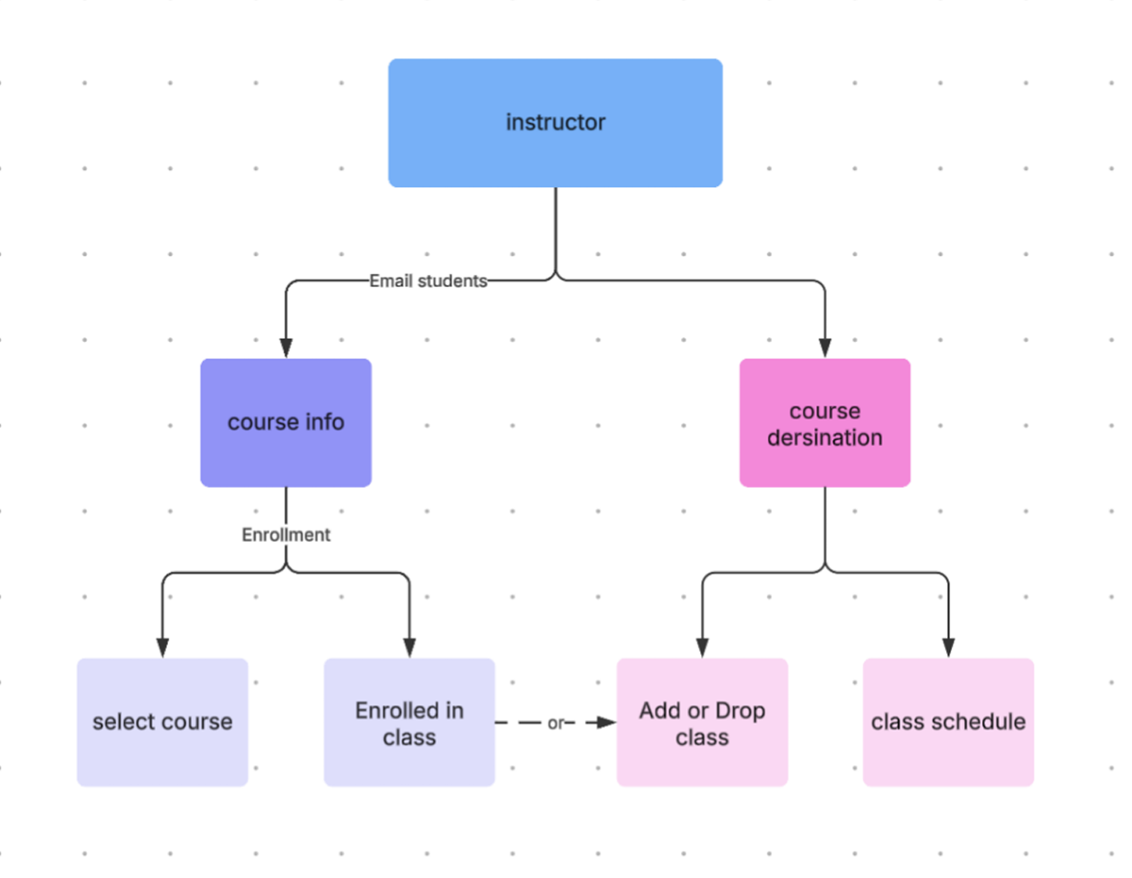
Design Integration

Slide 7
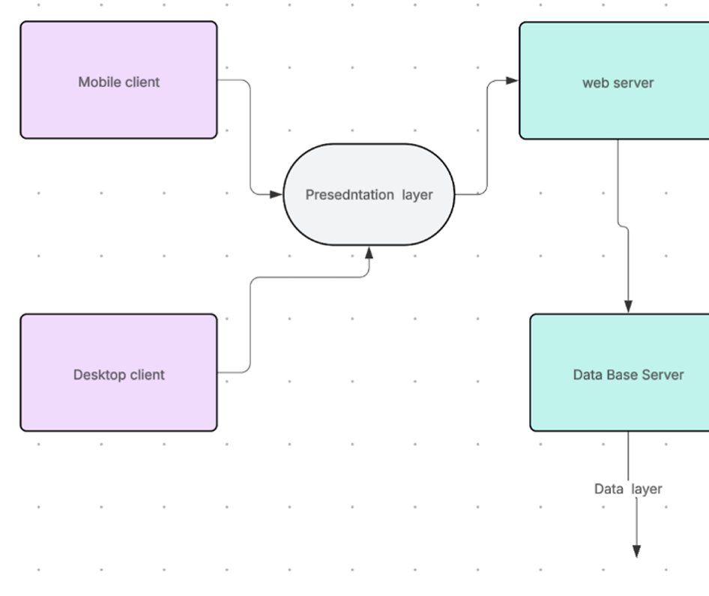
Architecture and UI

Slide 8
Technologies Used
Frontend: HTML, CSS, JavaScript (ReactJS)
Backend: Python (Flask)
Database: MySQL
APIs: RESTful
Version Control Systems: Git/GitHub

Slide 9
A Few Achievements
Complete development and implementation of full-stack.
Created a user-friendly interface.
Performed unit testing and integration.
Automated assignment data entry.

